Slide 1
Zodiac Redesign
By Ankit Dhyani

Slide 2
Design Process
Application Evaluation
Discovering Pain Points
Wireframing
Final Designs

Slide 3
Application Evaluation
Zodiac measures the maturity of an organization based on the process they are following and implementing at industry level.
If any organization is going with old set of norms/models and techniques like Waterfall, slow processes, etc. instead of new age automation/AI/ML and digitization, their maturity level decreases.
And Zodiac application also benefits the users/clients/organizations to increase their maturity level by letting them create an opportunity and by implementing the techniques/processes mentioned in non implemented section of the application.

Slide 4
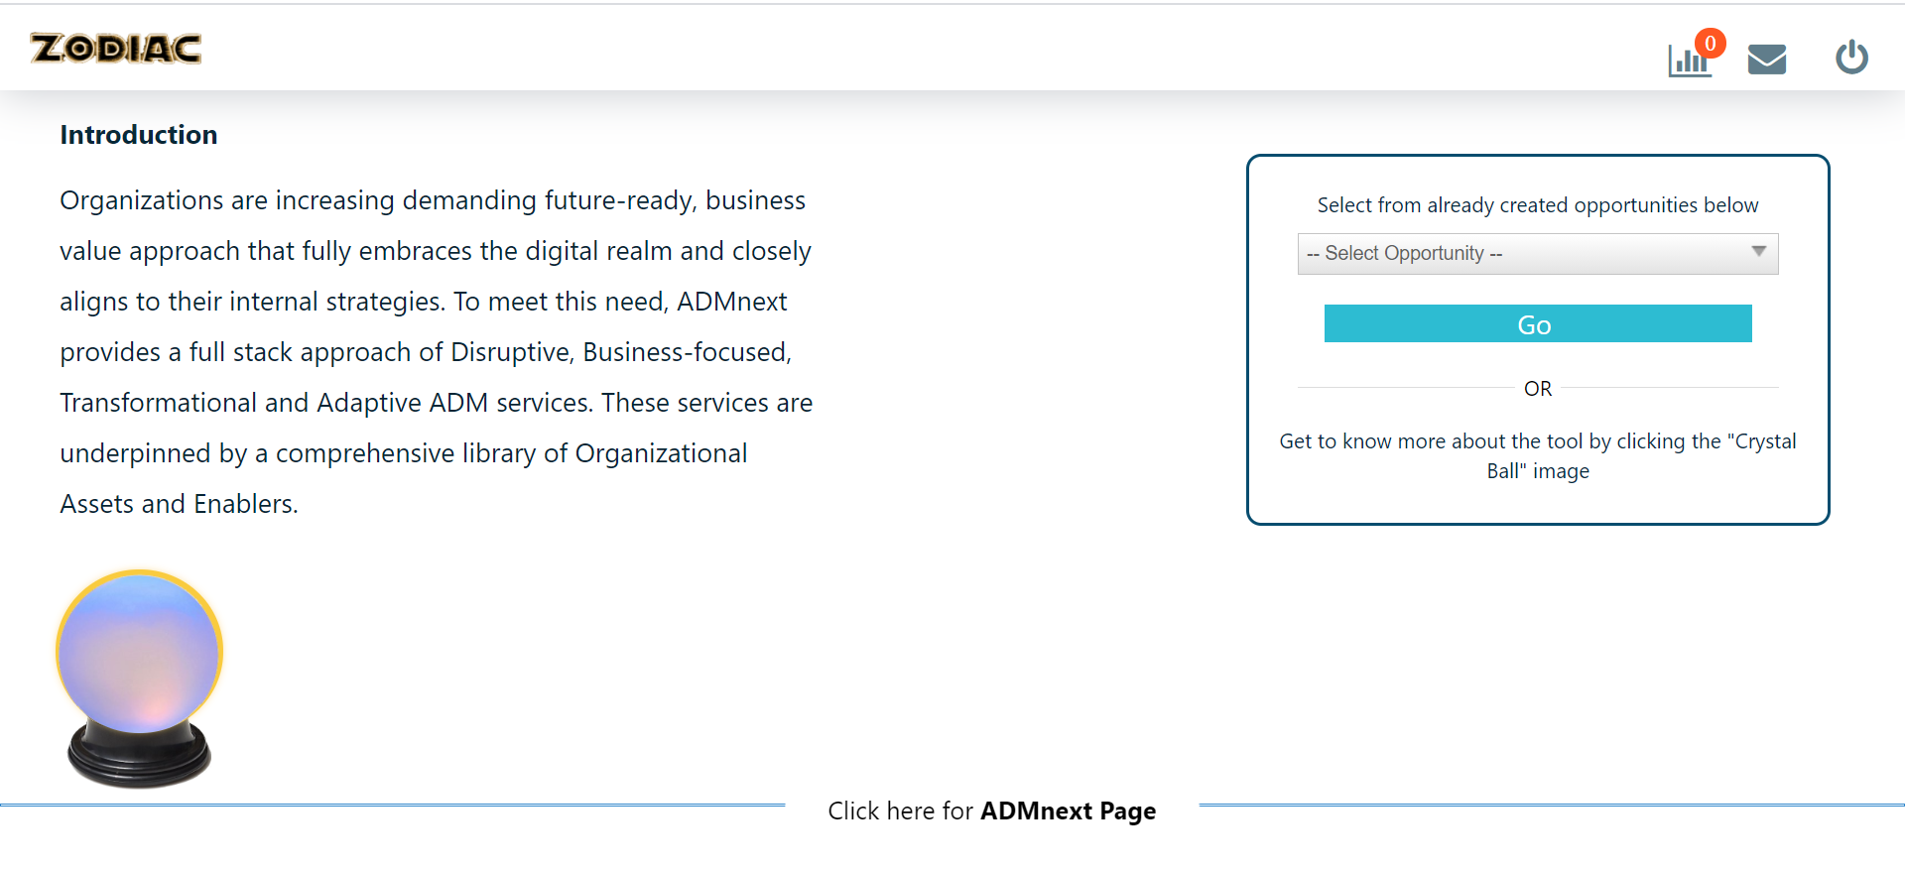
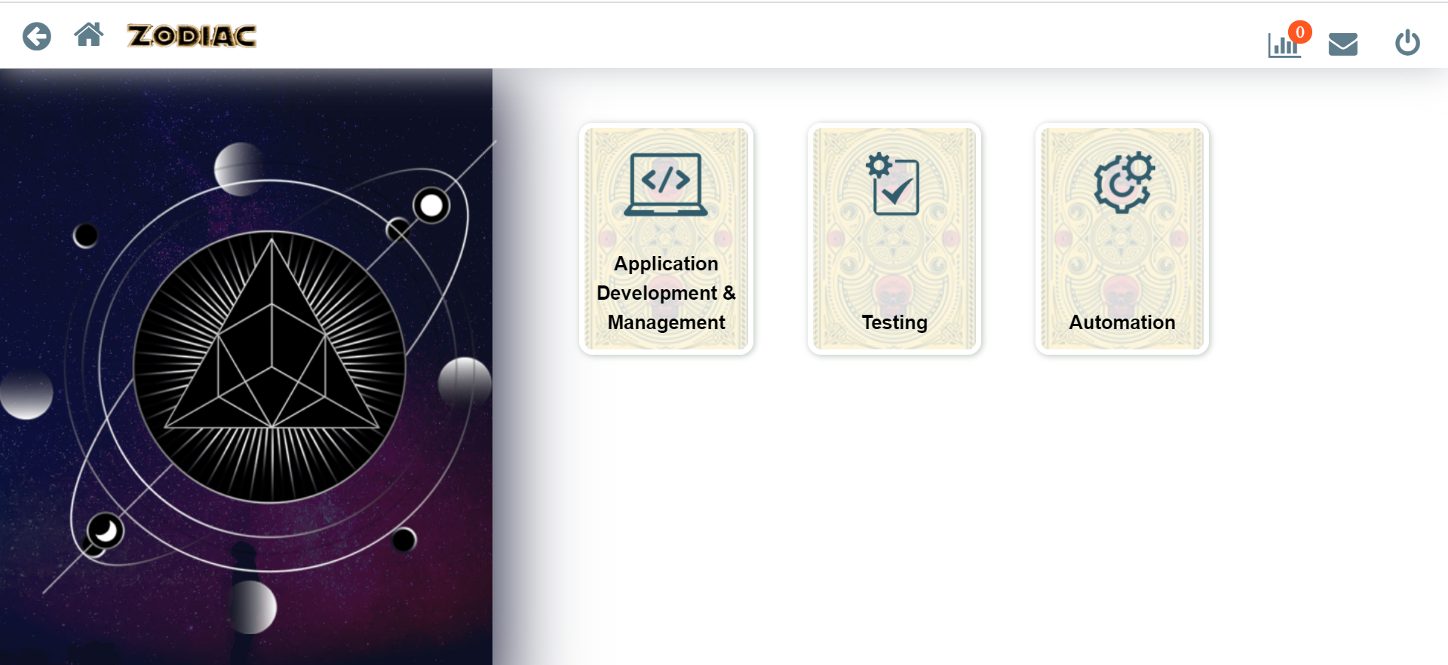
Pain Points
1
2
3
Home screen is cluttered.
Introduction part is long
Multi-step process to select previous opportunity.
GIF is grabbing more attention.
4

Slide 5
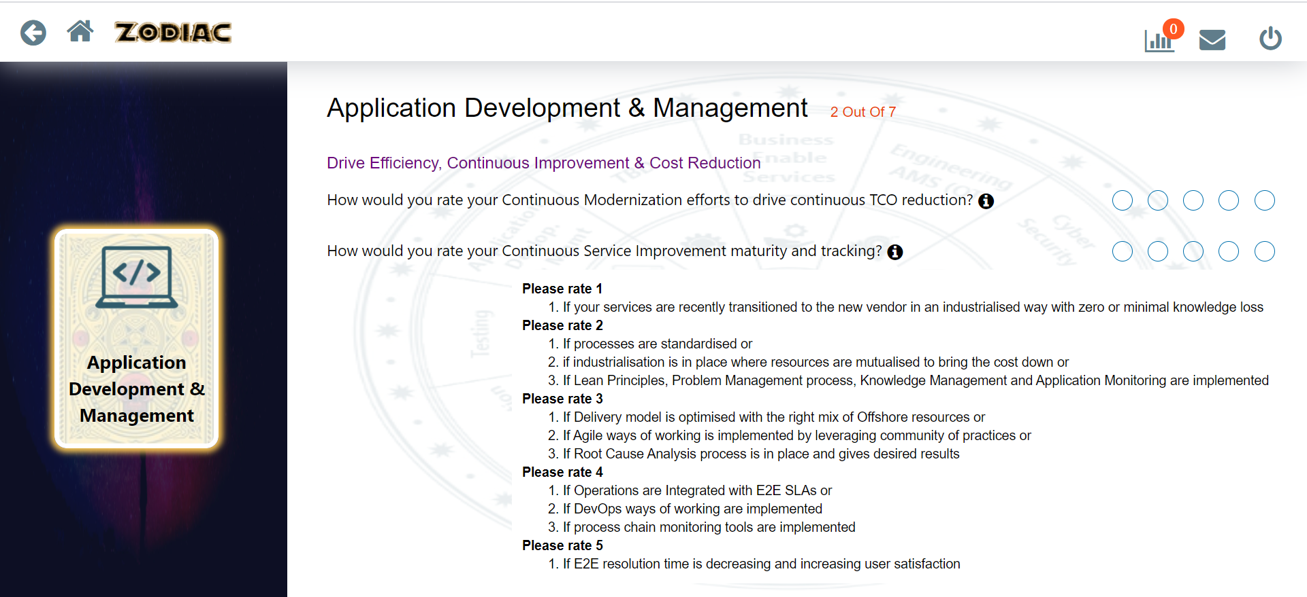
Pain Points
Hovering over “i” button is increasing cognitive load.
1

Slide 6
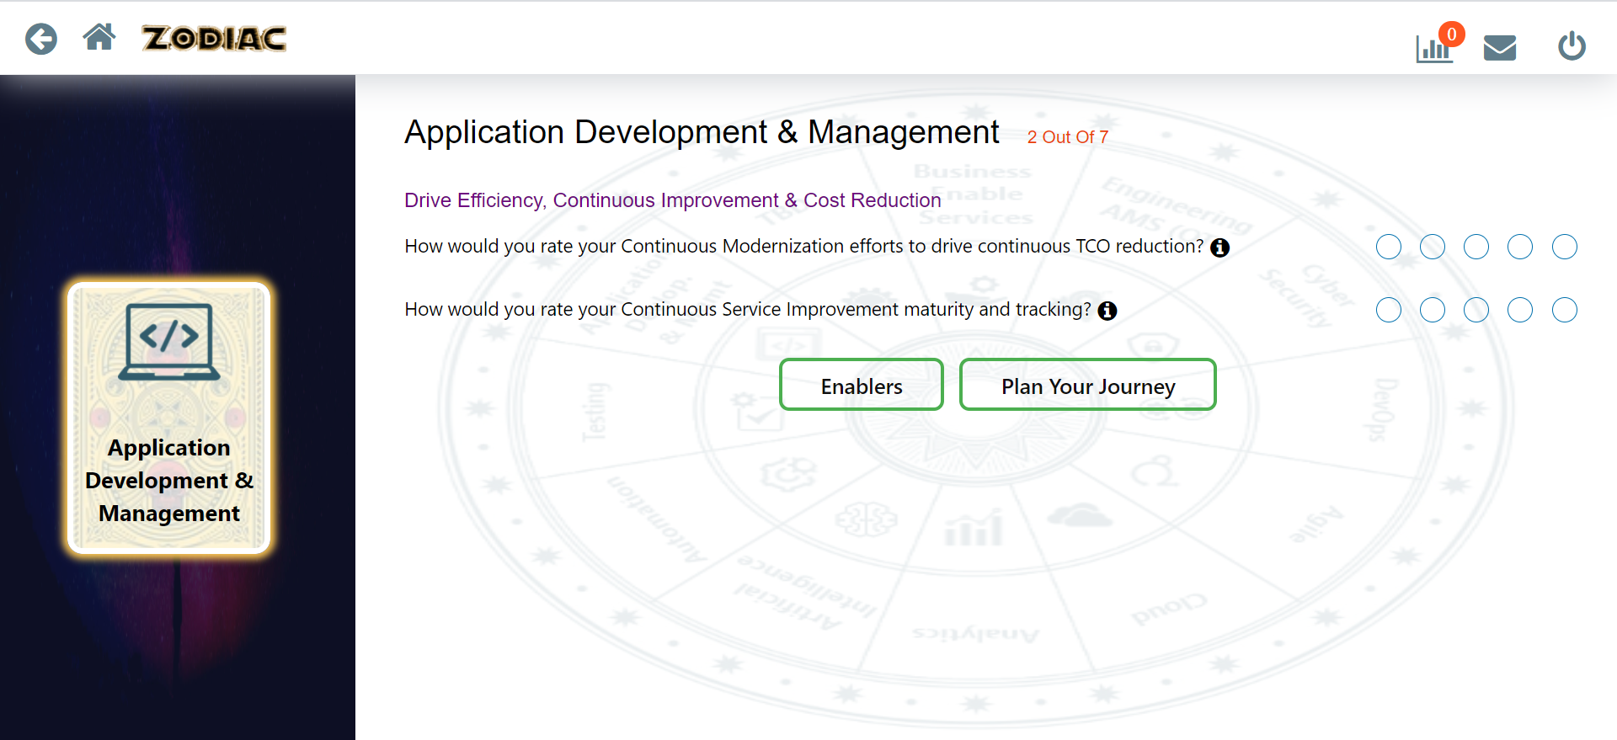
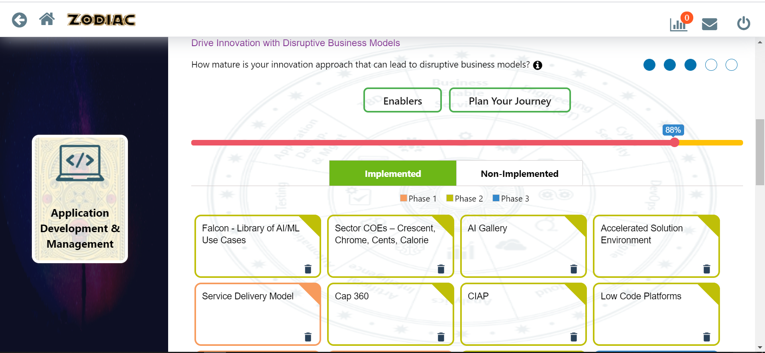
Pain Points
Buttons are creating a confusion.
Meaning of Enablers is not clear.
Purpose of progress bar is not mentioned
Recycle bin icon’s working is not mentioned.
2
1
3
4

Slide 7
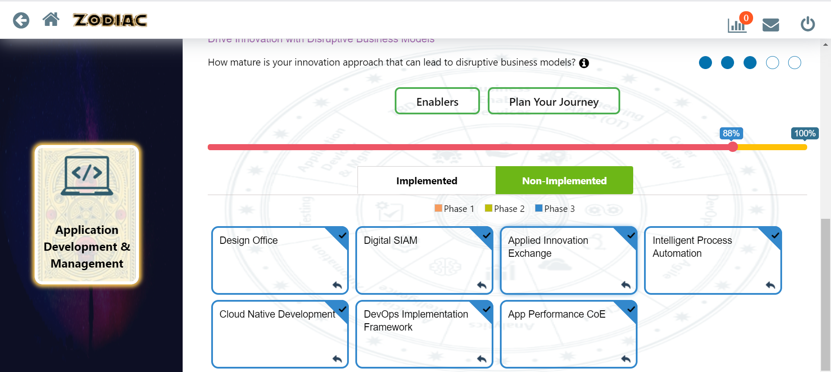
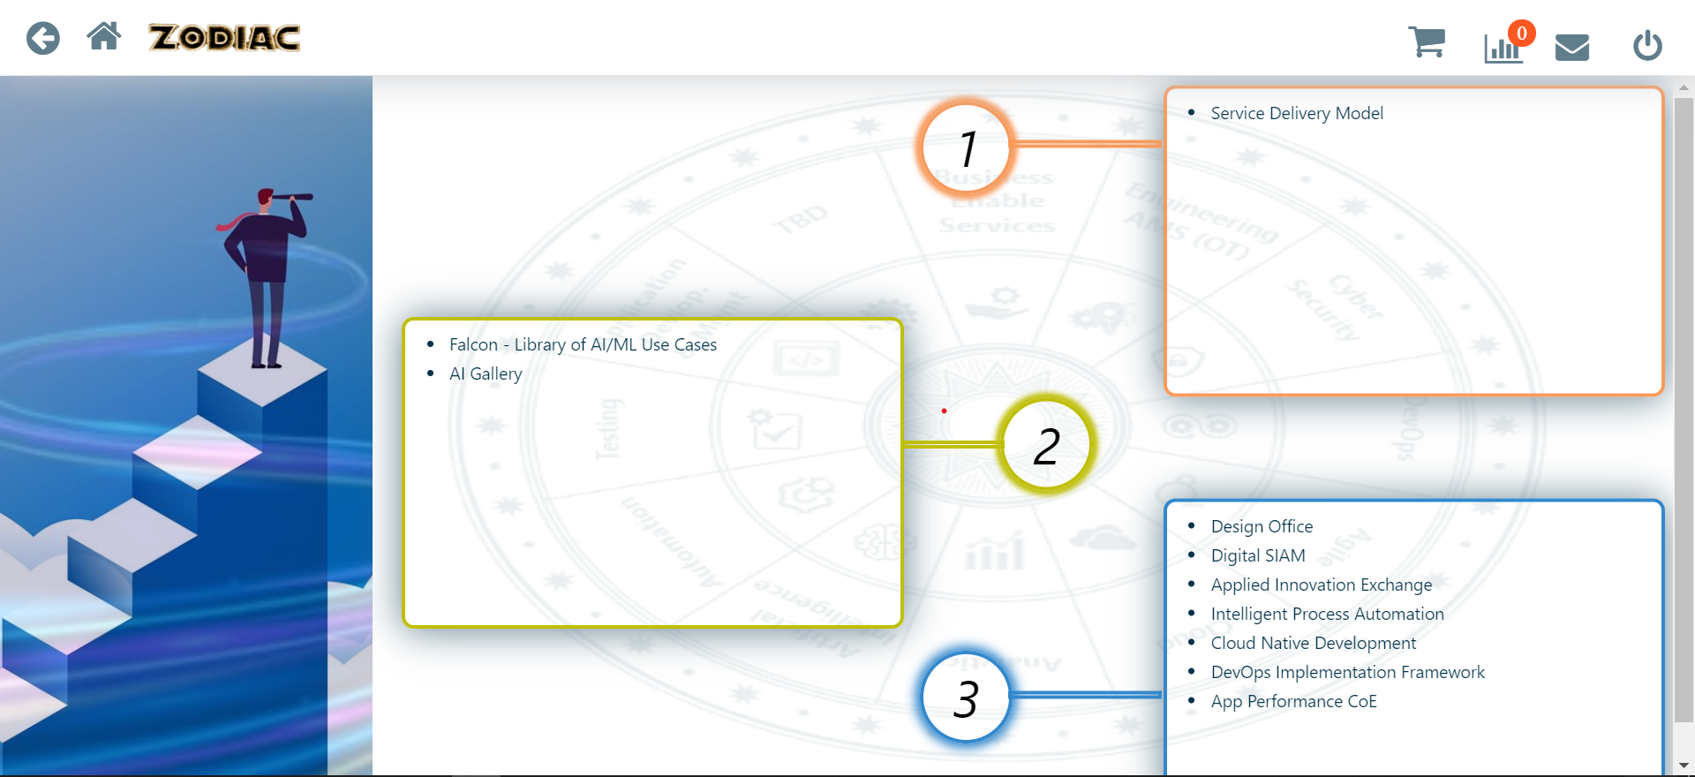
Pain Points
2
Purpose of selection in non-implemented process is not mentioned.
Increasing/decreasing of progress bar indicates nothing as of now.
Cart icon’s use is not mentioned.
Rearranging levers not mentioned
1
3

Slide 8
Visual Style Used
Capgemini’s own brand guidelines is used for better consistency and for a much recognized interface, which clients actually trusts upon.

Slide 9
Wireframes
Outline of a Webpage or an Application for a clear overview of the page structure and layout.

Slide 10
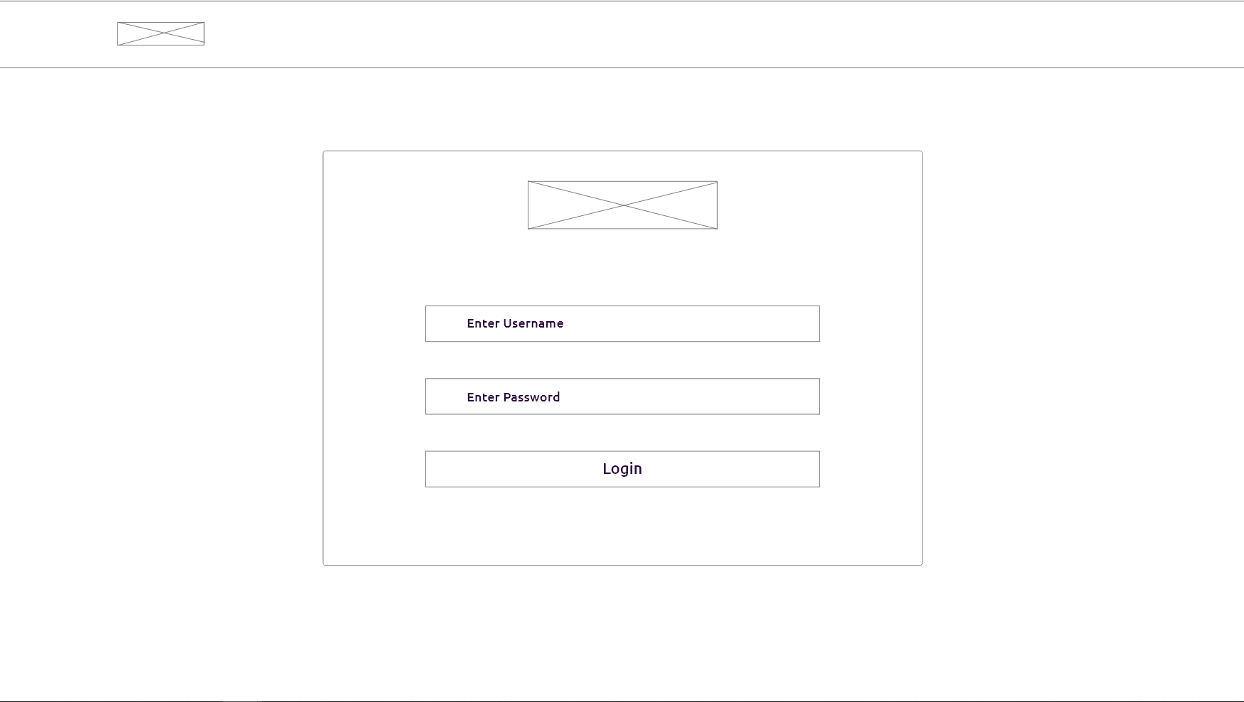
Login Screen

Slide 11
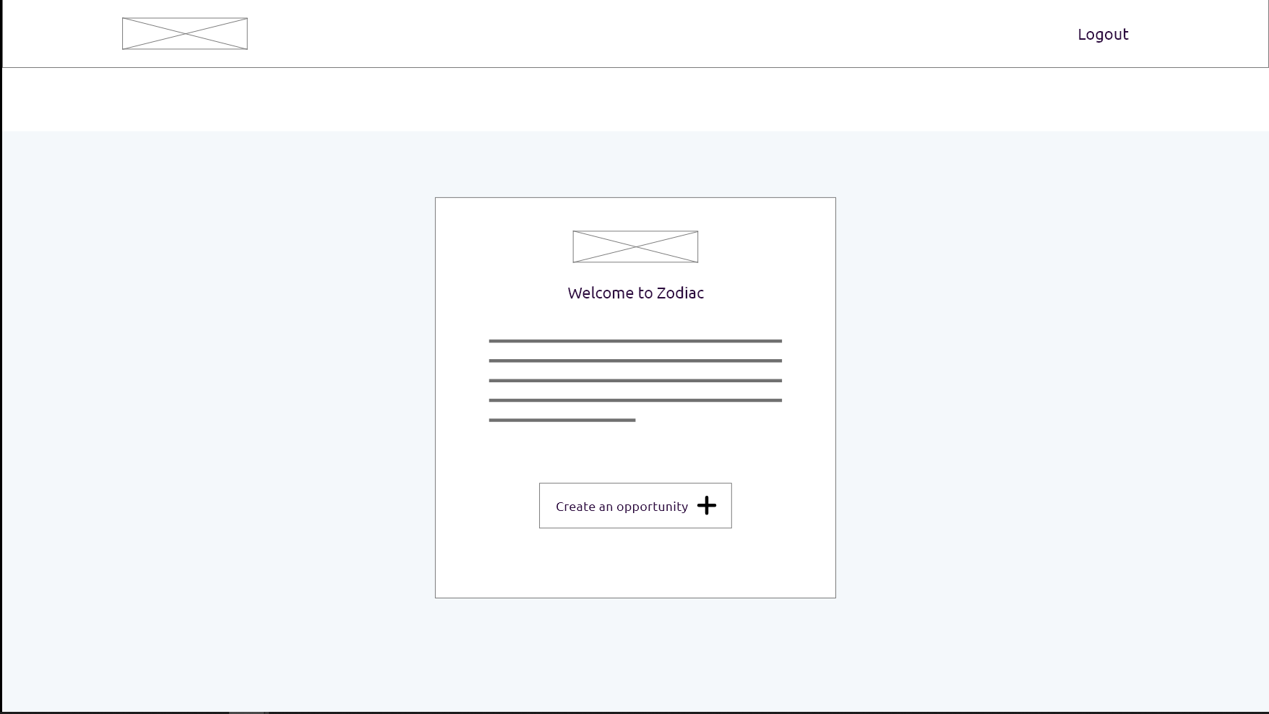
Home Screen

Slide 12
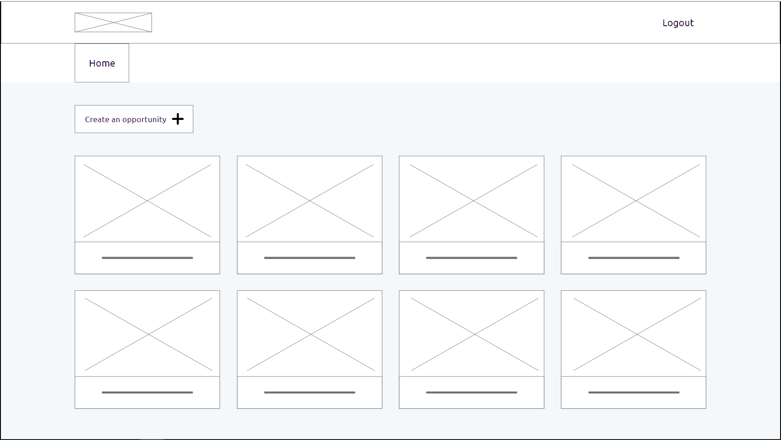
Opportunities Screen

Slide 13
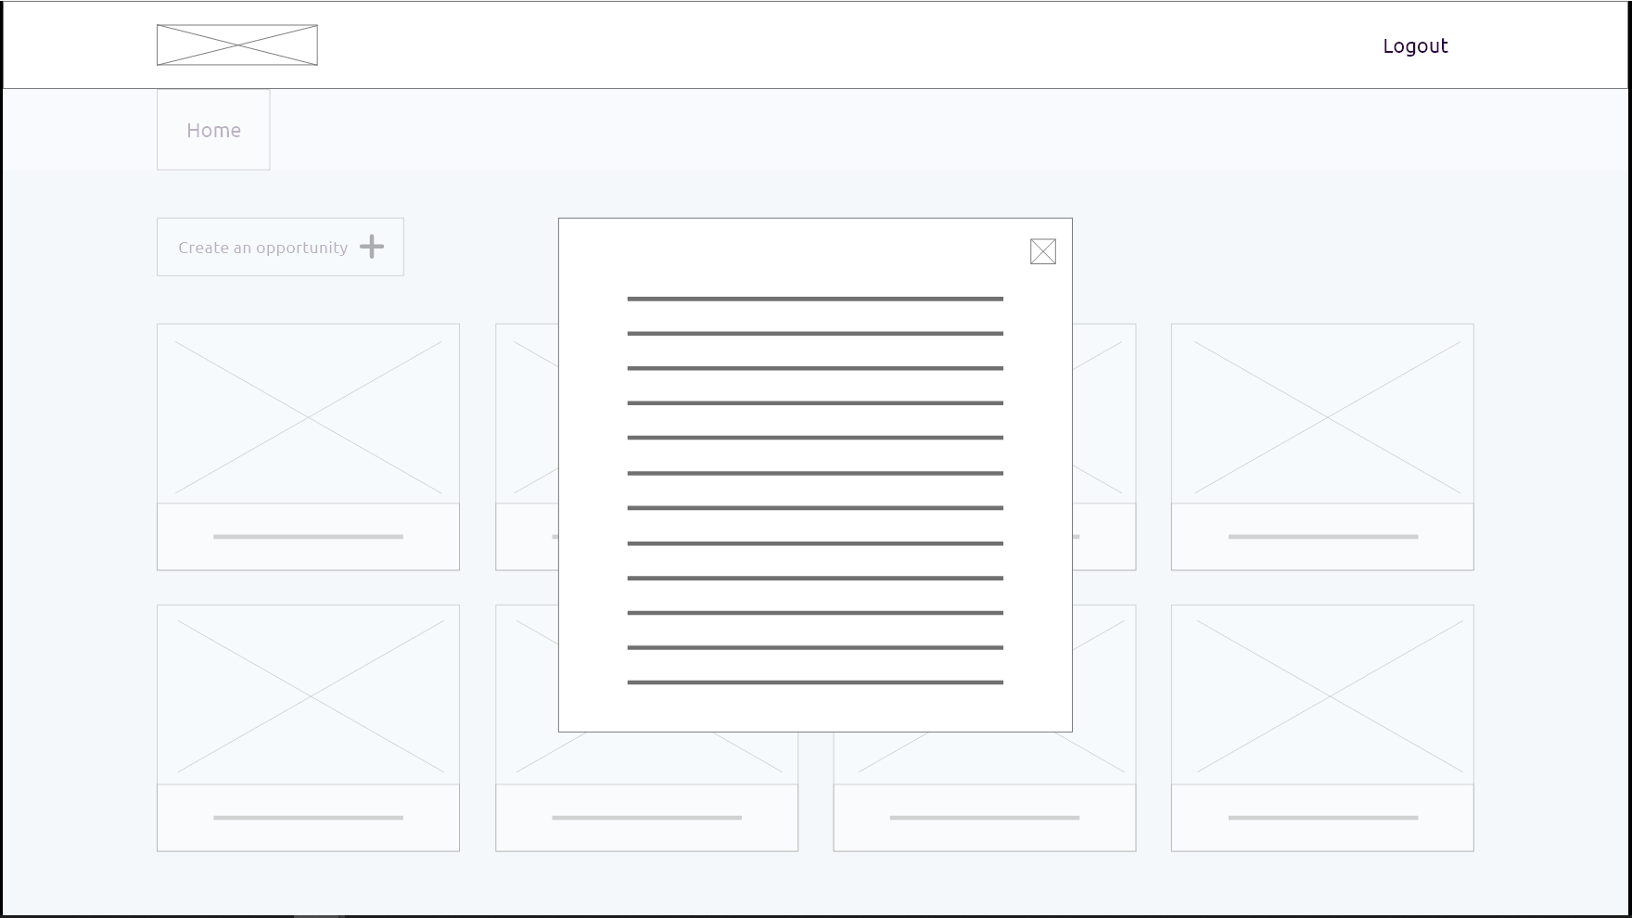
Selecting Module Screen

Slide 14
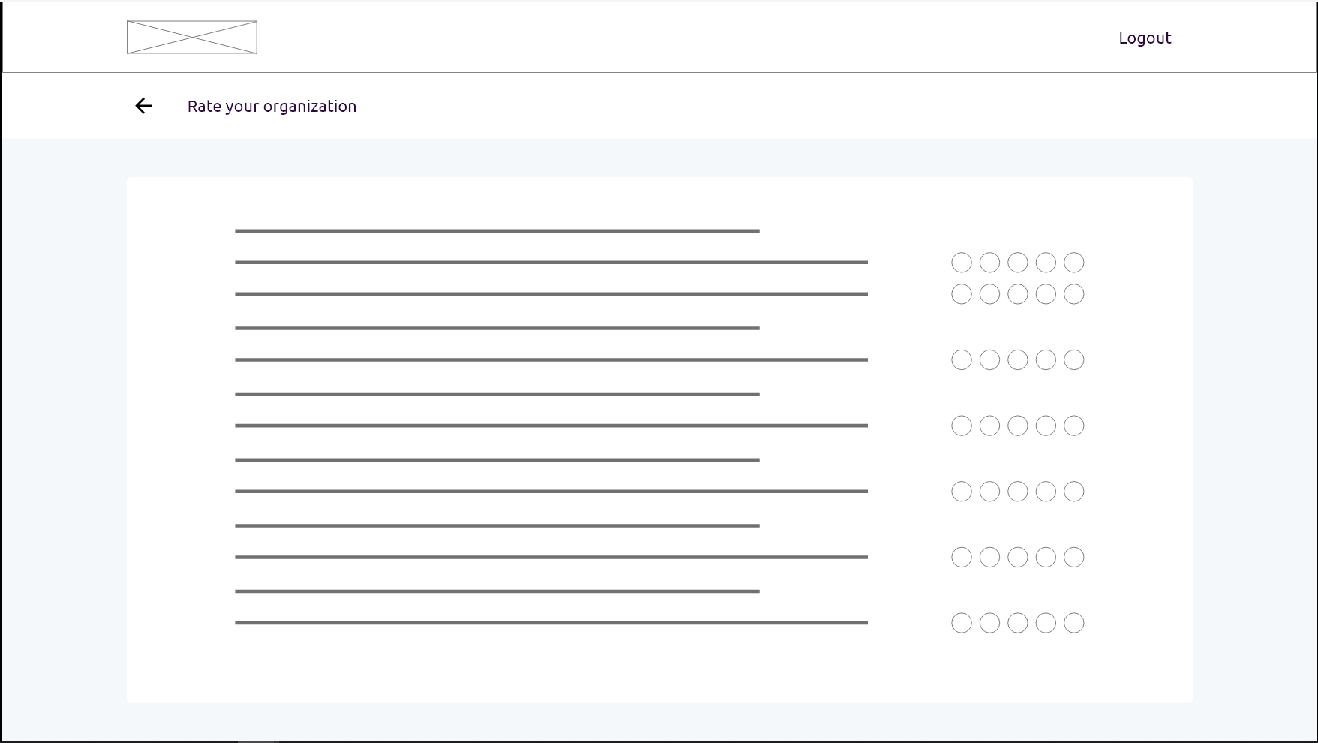
Question Screen

Slide 15
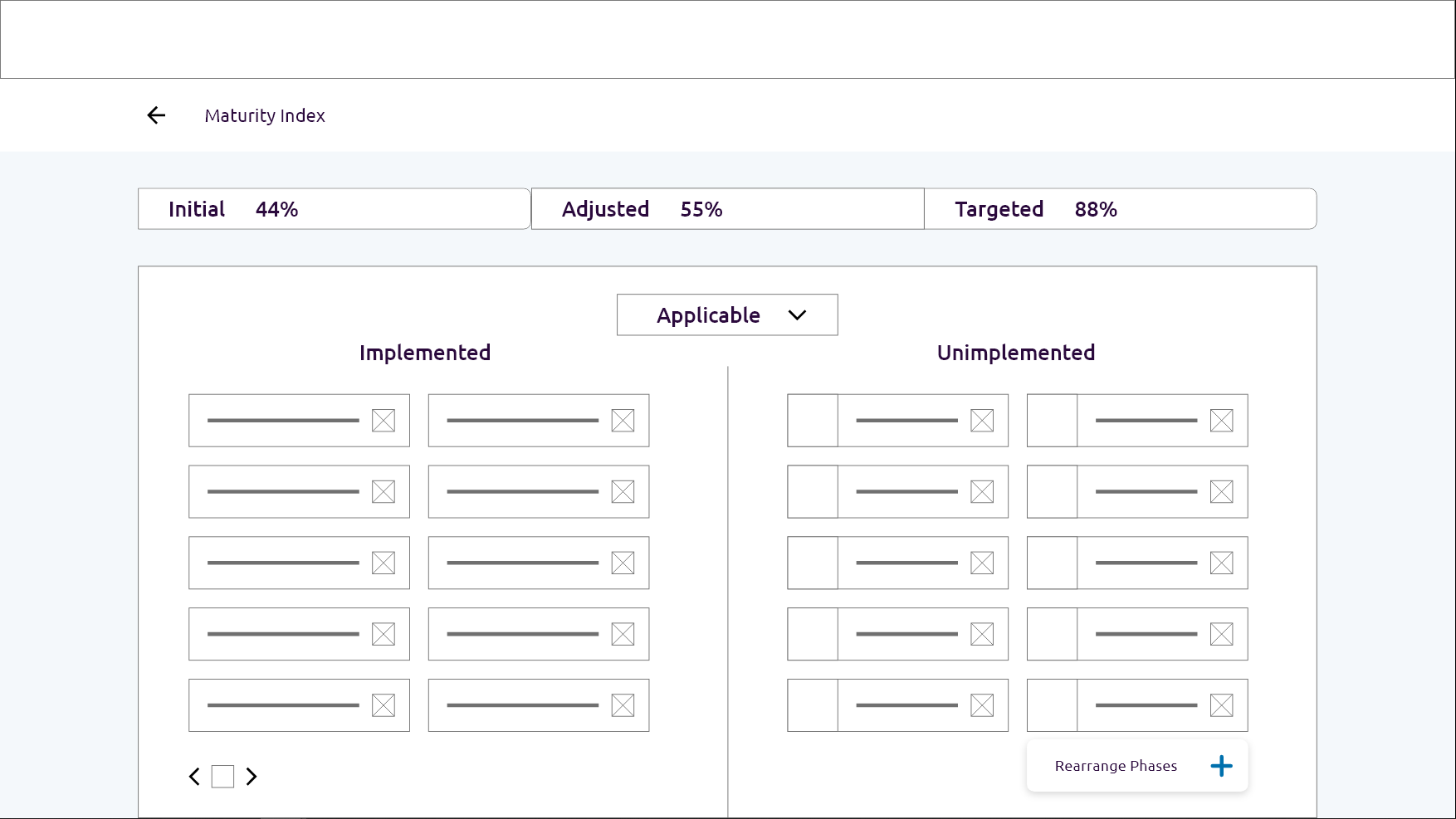
Maturity Index Screen

Slide 16
Final Design and Prototype
Let’s have a look to attached screenshots

Slide 17
